Slide 1
Fundamental of
Management
FACULTY OF BUSINESS MANAGEMENT

Slide 2
TOPIC 1:
Introduction to Management

Slide 3
Learning outcome
1. Define organization, management, and measuring managerial performance.
2. Provide examples of functions and activities,
management managerial
levels, skills and roles.
3. Explain the history and contributions of management theories.

Slide 4
Definition of Organization and Management
A group of individual who work together toward common goals.
Is a social entity that is goal directed and deliberately structured.
Organization

Slide 5
Manager
Someone who plans and makes decision , organizes ,leads and controls human, financial physical and information resources.

Slide 6
Management
Is the process of administering and coordinating resources effectively and efficiently in an effort to achieve the goals of the organization.
The process of planning ,organizing, leading and controlling the work of organization members and of using all available organizational resources to reach stated organizational goals

Slide 7
Measuring managerial Performance
 Effectiveness
Pursuing the appropriate goals- ―Doing the right things‖
 Efficiency
Using the fewest inputs to generate a given output- ―Doing things right‖

Slide 8
High
Effective but not efficient. Some resource are wasted | Effective & efficient. Goal are achieve & resource are well utilized, area of high productivity
Neither effective | Efficient but not
nor efficient, goal | effective, no
are not achieve, | wasted resource
resource wasted in | but goals not
the process | achieve
Goal attainment
Low
Poor
Good
Resource utilization

Slide 9
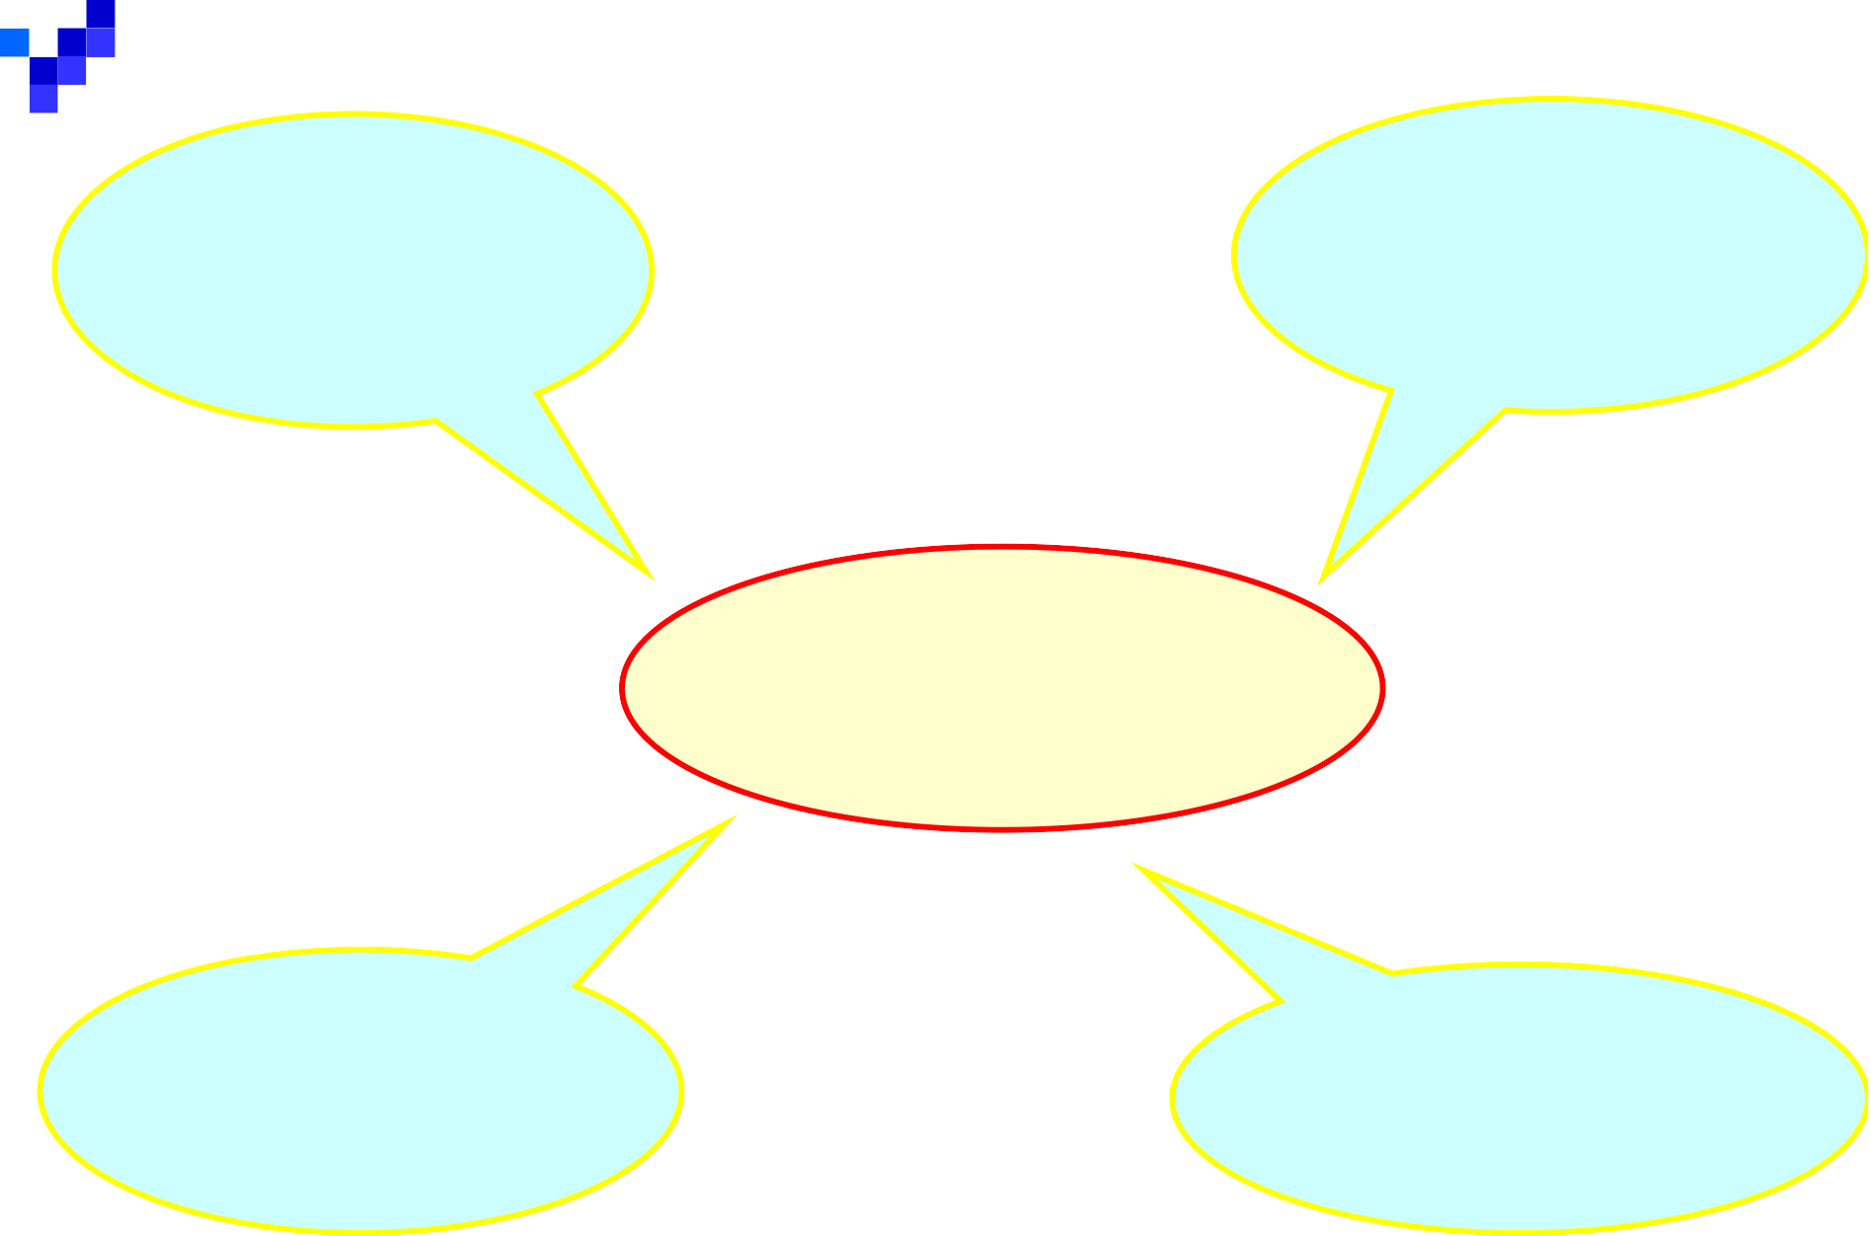
Organizing
Planning
Management Function
Leading
Controlling

Slide 10
Management process
PLANNING - Defining goals, establishing strategy, and developing plans to coordinate activities | ORGANIZING - Determine what task, who & how, who report to whom & where decision to be made
LEADING - Motivating, select effective communication channels & resolving conflict | CONTROLLING - Monitoring activities and correcting any significant deviation

Slide 11
Management Function and
Activities
 Planning
Setting goals and defining the actions necessary to achieve those goals.
Where the organization wants to be in the future and how to get there.
Defining goals for future organizational performance and deciding on the tasks and use of resources needed to attain them.

Slide 12
Cont…
 Organizing
The process of determining the tasks to be done ,who will do them and how those tasks will be managed and coordinated.
Also involved the assignment of task , grouping of tasks into department and the allocation of resources to department.

Slide 13
Cont…
 Leading
Motivating and directing the member of the organization so that they contribute to the achievement of the goals of the organization.
Use of influence to motivate employee to achieve organizational goals,-creating share culture and value , communication goals to employee throughout the organization and infusing employee with the desire to perform at a high level.

Slide 14
Cont..
- Leadership - is the ability to influence people towards the attainment of organization goals.
3 types:
Autocratic Leadership
leader retains full authority for decision making
Democratic /Participative Leadership
the leader accept some employees input but usually
use their authority to make decision
The leader delegates authority to others, encourages participation and relies on expert and referent power to influence subordinates
Free –rein Leadership (Laissez –Faire)
The leader delegates much authority to employees
Motivation – is the process of creating organizational condition that will result in employees striving and working toward the company goals.

Slide 15
Cont..
 Controlling
- Monitoring the performance of the organization , identifying deviations between planned and actual results and taking corrective action when necessary.

Slide 16
Managerial Levels
 Top (high) Management Top Level Managers
 Middle Management – Middle Managers
 First-Line Management – Supervisory
 Operational Employees.

Slide 17
Managerial levels
1. First-line managers/ lower level manager
- Direct operating employees only, they do not supervise other managers.
2. Middle manager
Direct the activities that implement their organization policies
Balance the demands of their superiors with the capacity of their subordinates.

Slide 18
3. Top managers
Responsible for the overall management of the organization.
Establish operating policies & guides the organization‘s interactions with its environment.

Slide 19
Managerial Skills
 Conceptual Skills (Analytical Skills)
The ability to analyze complex situations and respond effectively to the challenges faced by the organization.
 Interpersonal Skill( Human Skill)
Ability to work effectively with members of one‘s workgroup as well as with other work groups within the organization

Slide 20
Cont..
 Technical Skills
The ability to utilize tools, techniques and procedures that are specific to a particular field
 Decision Making Skill
The ability to make a good decision making

Slide 21
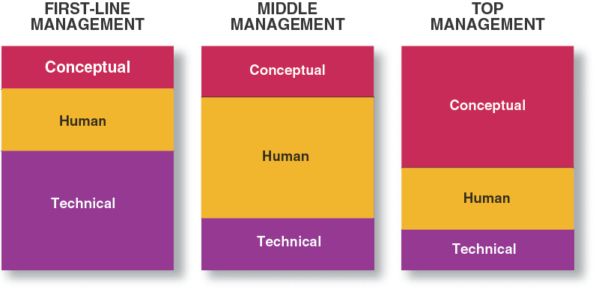
Skills Needed at Different Levels of Management

Slide 22
Managerial Roles – developed by Henry Mintzberg
A Role is a set of expectation for a manager ‗s behaviors
 Interpersonal Roles – helps the managers in managing
the organizational smoothly
Figurehead – Managers may have to appear at community function, attend social events and signing legal documents
Leader – Responsibility for the success/failure of their work groups. A person responsible for hiring, training and motivating subordinates in organization.
Liaison – A person who perform and interacts with other people outside the organizations.

Slide 23
Cont…
 Informational Roles – managers responsible for ensuring that the people with whom they work have sufficient information to do their jobs effectively
Monitor – Managers seek out information from their subordinates.
Disseminator – information receive internally/externally will be transmitted to the subordinates.
Spokesperson – Managers must often communicate information to individuals outside their units and their organizations.

Slide 24
Cont…
Decisional Roles – Managers responsibility for processing information and reaching conclusions.
Entrepreneur – Managers initiates projects that capitalize on opportunities and have been identified
Disturbance Handler – Managers is responsible for corrective actions when the organizations faces important and unexpected disturbances
Resources Allocator – Managers is responsible in
allocating the resources or the organizations
Negotiator – Managers may negotiate with employees, suppliers, customers or other workgroups

Slide 25
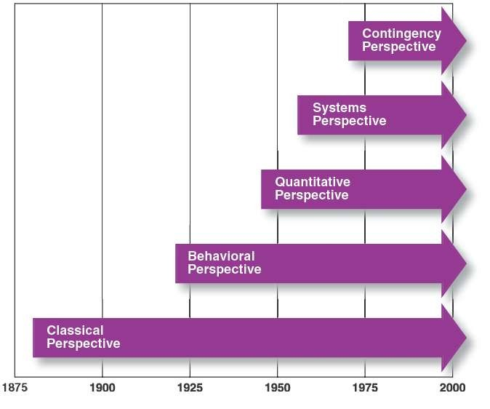
Figure 2.1 Chronological Development of Management Perspectives

Slide 26
Comprehensive Analysis of Management
1) Classical approach to management resulted from the first significant, concentrated effort to develop a body of management thought. Management writers who participated in this efforts are considered the pioneer of management study.

Slide 27
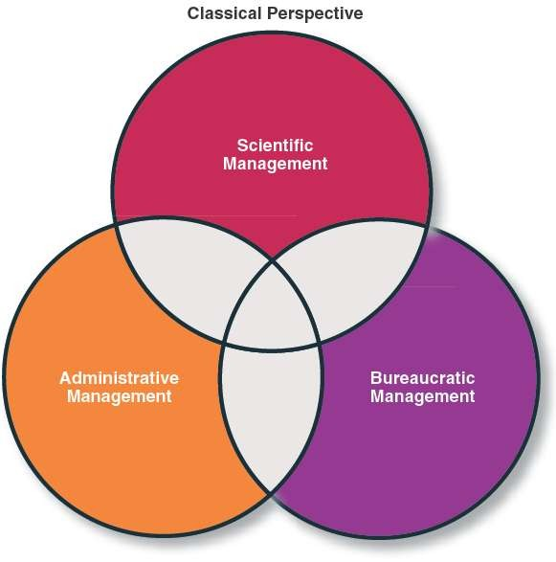
Subfields of the Classical Perspective on Management
Focuses on the
individual worker’s productivity
Focuses on the overall organizational system
Focuses on the functions of management

Slide 28
1a) Scientific Management: Taylor
Frederick W. Taylor (1856-1915)
Father of ―Scientific Management.
attempted to define ―the one best way‖ to perform every task through systematic study and other scientific methods.
believed that improved management practices lead to improved productivity.
Three areas of focus:
Task Performance
Supervision
Motivation

Slide 29
Task Performance
Scientific management incorporates basic expectations of management, including:
Development of work standards
Selection of workers
Training of workers
Support of workers

Slide 30
Supervision
Taylor felt that a single supervisor could not be an expert at all tasks.
As a result, each first-level supervisor should be responsible only workers who perform a common function familiar to the supervisor.
This became known as ―Functional Foremanship.‖

Slide 31
Motivation
Taylor believed money was the way to motivate workers to their fullest capabilities.
He advocated a piecework system in which worker‘s pay was tied to their output.
Workers who met a standard level of production were paid a standard wage rate.
Workers whose production exceeded the standard were paid at a higher rate for all of their production output.

Slide 32
1b) Administrative Management: Fayol
Henri Fayol (1841–1925)
First recognized that successful managers had to understand the basic managerial functions.
Developed a set of 14 general principles of management.
Fayol‘s managerial functions of planning, leading, organizing and controlling are routinely used in modern organizations.

Slide 33
1. Division of work
Table 2.1
Centralization
Scalar chain
Order
Equity
Stability
Initiative
Esprit de corps
Authority and responsibility
Discipline
Unity of command
Unity of direction
Subordination of individual interest to the common good
Remuneration of personnel
Source: Based on Henri Fayol, General and Industrial Management, trans. Constana Storrs (London: Pittman & Sons, 1949).

Slide 34
1c) Bureaucratic Management
Focuses on the overall organizational system.
Bureaucratic management is based upon:
Firm rules
Policies and procedures
A fixed hierarchy
A clear division of labor

Slide 35
Bureaucratic Management: Weber
Max Weber (1864–1920)
A German sociologist and historian who envisioned a system of management that would be based upon impersonal and rational behavior—the approach to management now referred to as ―bureaucracy.‖
Division of labor
Hierarchy of authority
Rules and procedures
Impersonality
Employee selection and promotion

Slide 36
Weber‘s Forms of Authority
Traditional authority
Subordinate obedience based upon custom or tradition (e.g., kings, queens, chiefs).
Charismatic authority
Subordinates voluntarily comply with a leader because of his or her special personal qualities or abilities (e.g., Martin Luther King, Gandhi).
Rational-legal authority
Subordinate obedience based upon the position held by superiors within the organization (e.g., police officers, executives, supervisors).

Slide 37
Classical versus Behavioral Perspective
vs.
Classical Perspective
Behavioral Perspective
Focused on rational behavior
Acknowledged the importance of human behavior

Slide 38
2) Behavioral Perspective
Followed the classical perspective in the development of management thought.
Acknowledged the importance of human behavior in shaping management style
Is associated with:
Mary Parker Follett
Elton Mayo
Douglas McGregor

Slide 39
Mary Parker Follett
Concluded that a key to effective management was coordination.
Felt that managers needed to coordinate and harmonize group effort rather than force and coerce people.
Believed that management is a continuous, dynamic process.
Felt that the best decisions would be made by people who were closest to the situation.

Slide 40
Follett on Effective Work Groups
Four principles of coordination to promote effective work groups:
Coordination requires that people be in direct contact with one another.
Coordination is essential during the initial stages of any endeavor.
Coordination must address all factors and phases of any endeavor.
Coordination is a continuous, ongoing process.

Slide 41
Elton Mayo
Conducted the famous Hawthorne Experiments.
―Hawthorne Effect‖
Productivity increased because attention was paid to the workers in the experiment.
Phenomenon whereby individual or group performance is influenced by human behavior factors.
His work represents the transition from scientific management to the early human relations movement.

Slide 42
Douglas McGregor
Proposed the Theory X and Theory Y styles of management.
Theory X managers perceive that their subordinates have an inherent dislike of work and will avoid it if at all possible.
Theory Y managers perceive that their subordinates enjoy work and that they will gain satisfaction from performing their jobs.

Slide 43
Table 2.3
Comparison of Theory X and Theory Y Assumptions
Factor
Employee attitude toward work
Theory X Assumptions
Employees dislike work and will avoid it if at all possible.
Theory Y Assumptions
Employees enjoy work and will actively seek it.
Management view of direction
Employees must be directed, coerced, controlled, or threatened
to get them to put forth adequate effort.
Employees are self-motivated
and self-directed toward achieving organizational goals.
Employee view of direction
Employees wish to avoid responsibility; they prefer to be directed and told what to do and how to do it.
Employees seek responsibility; they wish to use their creativity, imagination, and ingenuity in performing their jobs.
Participatory style of management
Management style
Authoritarian style of management

Slide 44
3)The Contingency Perspective
A view that proposes that there is no one best approach to management for all situations.
Asserts that managers are responsible for determining which managerial approach is likely to be most effective in a given situation.
This requires managers to identify the key contingencies in a given situation.

Slide 45
4) The system Approach
Views the organization as a unified, directed system of interrelated parts.
The systems sees each change in a part of the system as having an impact on all others parts.
The system helps managers to realize that every action has consequences somewhere inside as outside the organization.

Slide 46
Comprises of two systems
Open system
characterized by interaction with external environment
Closed system
interaction with internal environment (do not interact with external)

Slide 47
External environment
Conversion (comprise the tech used to convert inputs to outputs
Input
(the physical, human, material, financial & info process)
Output
(the original inputs as & changed by transformation process
Feedback
(info about a system‘s status & performance

Slide 48
End of Chapter 1

